Slide 1
Working Drawings
(Production Drawings)
Xinli Wu
The Penn State University

Slide 2
Objectives
Define working drawings
Describe how working drawings are used in industry
List the major components of a complete set of working drawings
Describe the difference between detail and assembly drawings

Slide 3
1. Introduction
Working drawings are specialized engineering drawings that provide information required to make the part or assembly of the final design.
Working drawings rely on orthographic projection and many other graphical techniques to communicate design information for production.

Slide 4
2. Definition of Working
Drawings
The drawings from which a design is built;
Are legal contacts that document the design details and specifications.

Slide 5
Major components of a complete set of working drawings:
An assembly or subassembly drawing showing all the standard and nonstandard parts in a single drawing.
Detail drawing of each nonstandard part.
A bill of material (BOM)-- parts list.
A title block.

Slide 6
3. Assembly Drawing
An assembly drawing shows how each part of a design is put together. (If a design depicted is only part of a total assembly, it is referred to as a subassembly.)

Slide 7
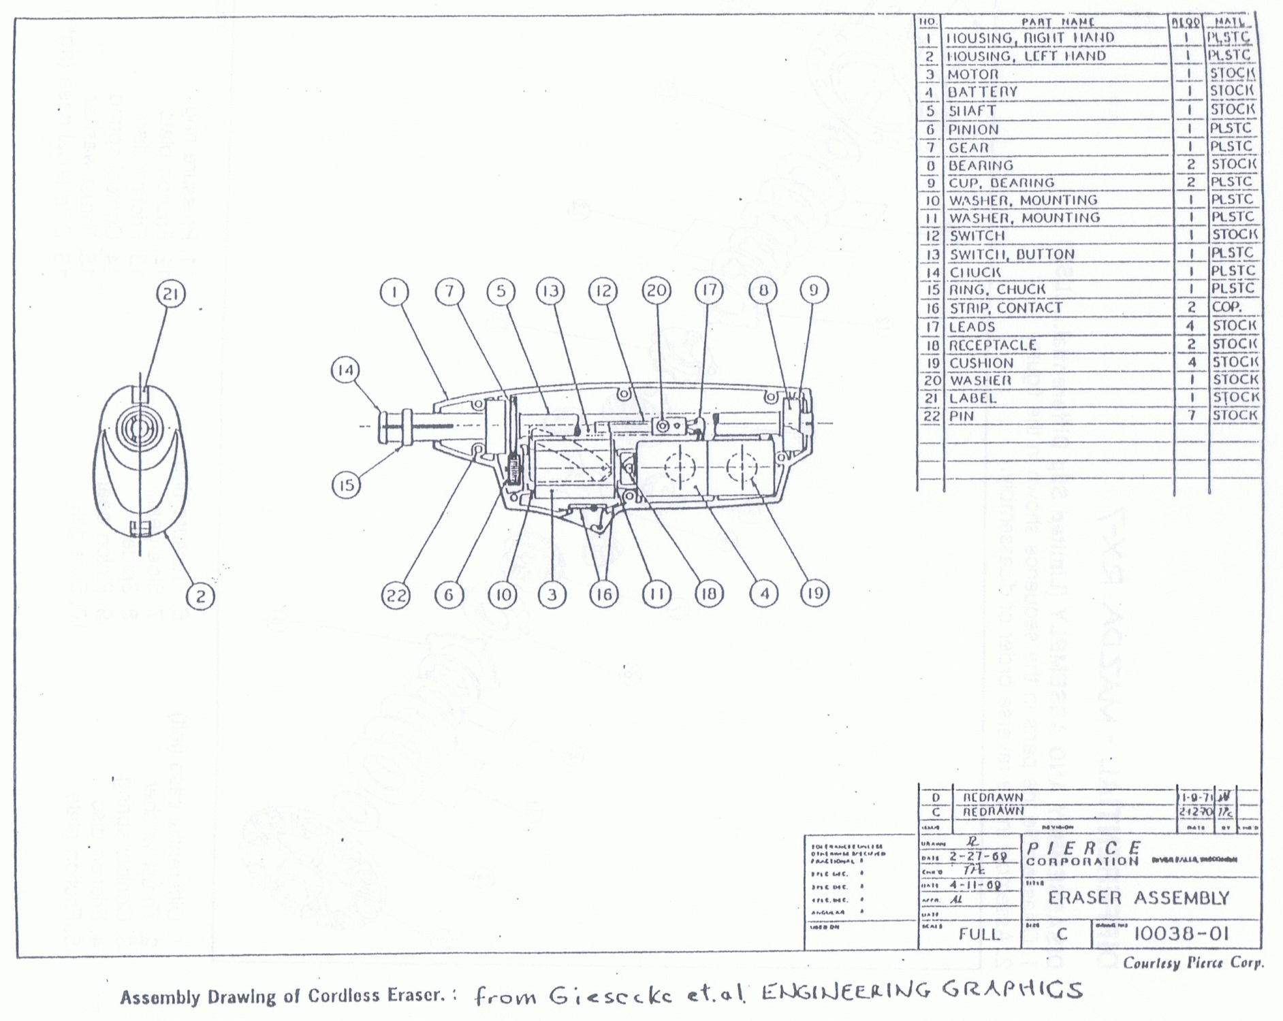

Slide 8
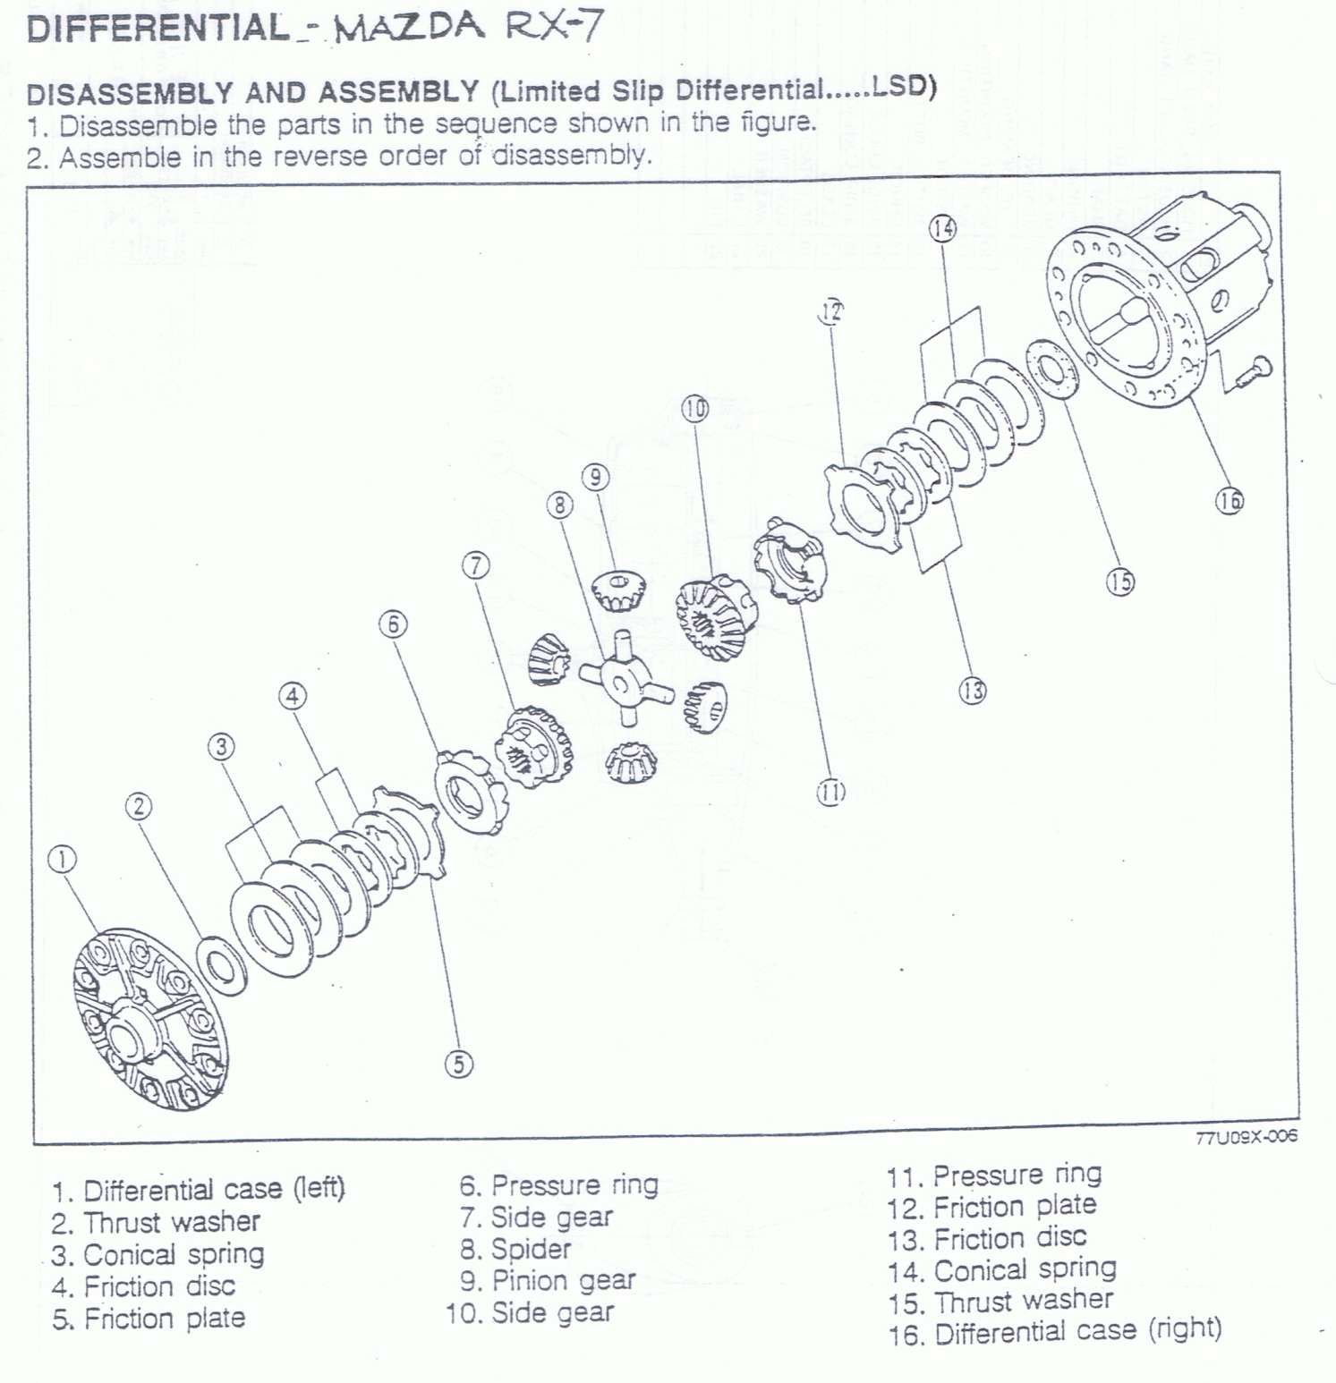

Slide 9
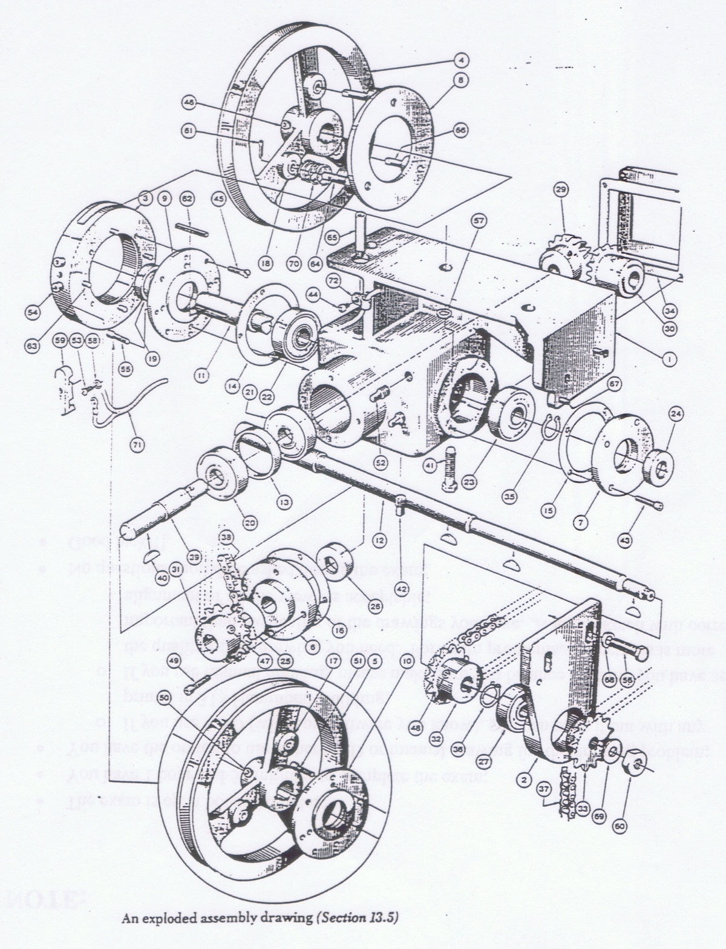

Slide 10
-- continued
Components in an assembly drawing includes: (1) all the parts, drawn in their operating position; (2) A parts list or bill of materials (BOM); (3) leader lines with balloons, assigning each part a detail number, in sequential order; (4) machining and assembly operations and critical dimensions related to those functions.

Slide 11
-- continued
Assembly drawings maybe pictorial drawings or orthographic drawings
Assembly drawings maybe exploded or not. Exploded assembly drawings show the parts pulled apart but they still line up.

Slide 12
4. Parts List
Consists of an itemized list of all the parts to assemble one complete unit
Contain the following: (1) part number (2) part name (3) number of parts req’d (4) material (5) description

Slide 13
-- continued
Parts list placed above the title block should be read from the bottom to the top
Parts list placed at the top of a sheet should be read from top to bottom
Position of the parts list is your choice

Slide 14
5. Detail Drawings
Each nonstandard part will receive a detail drawing showing how the part looks when completed.
It completely describe the part giving everything one needs to make it, including shape, size, material, finish.

Slide 15
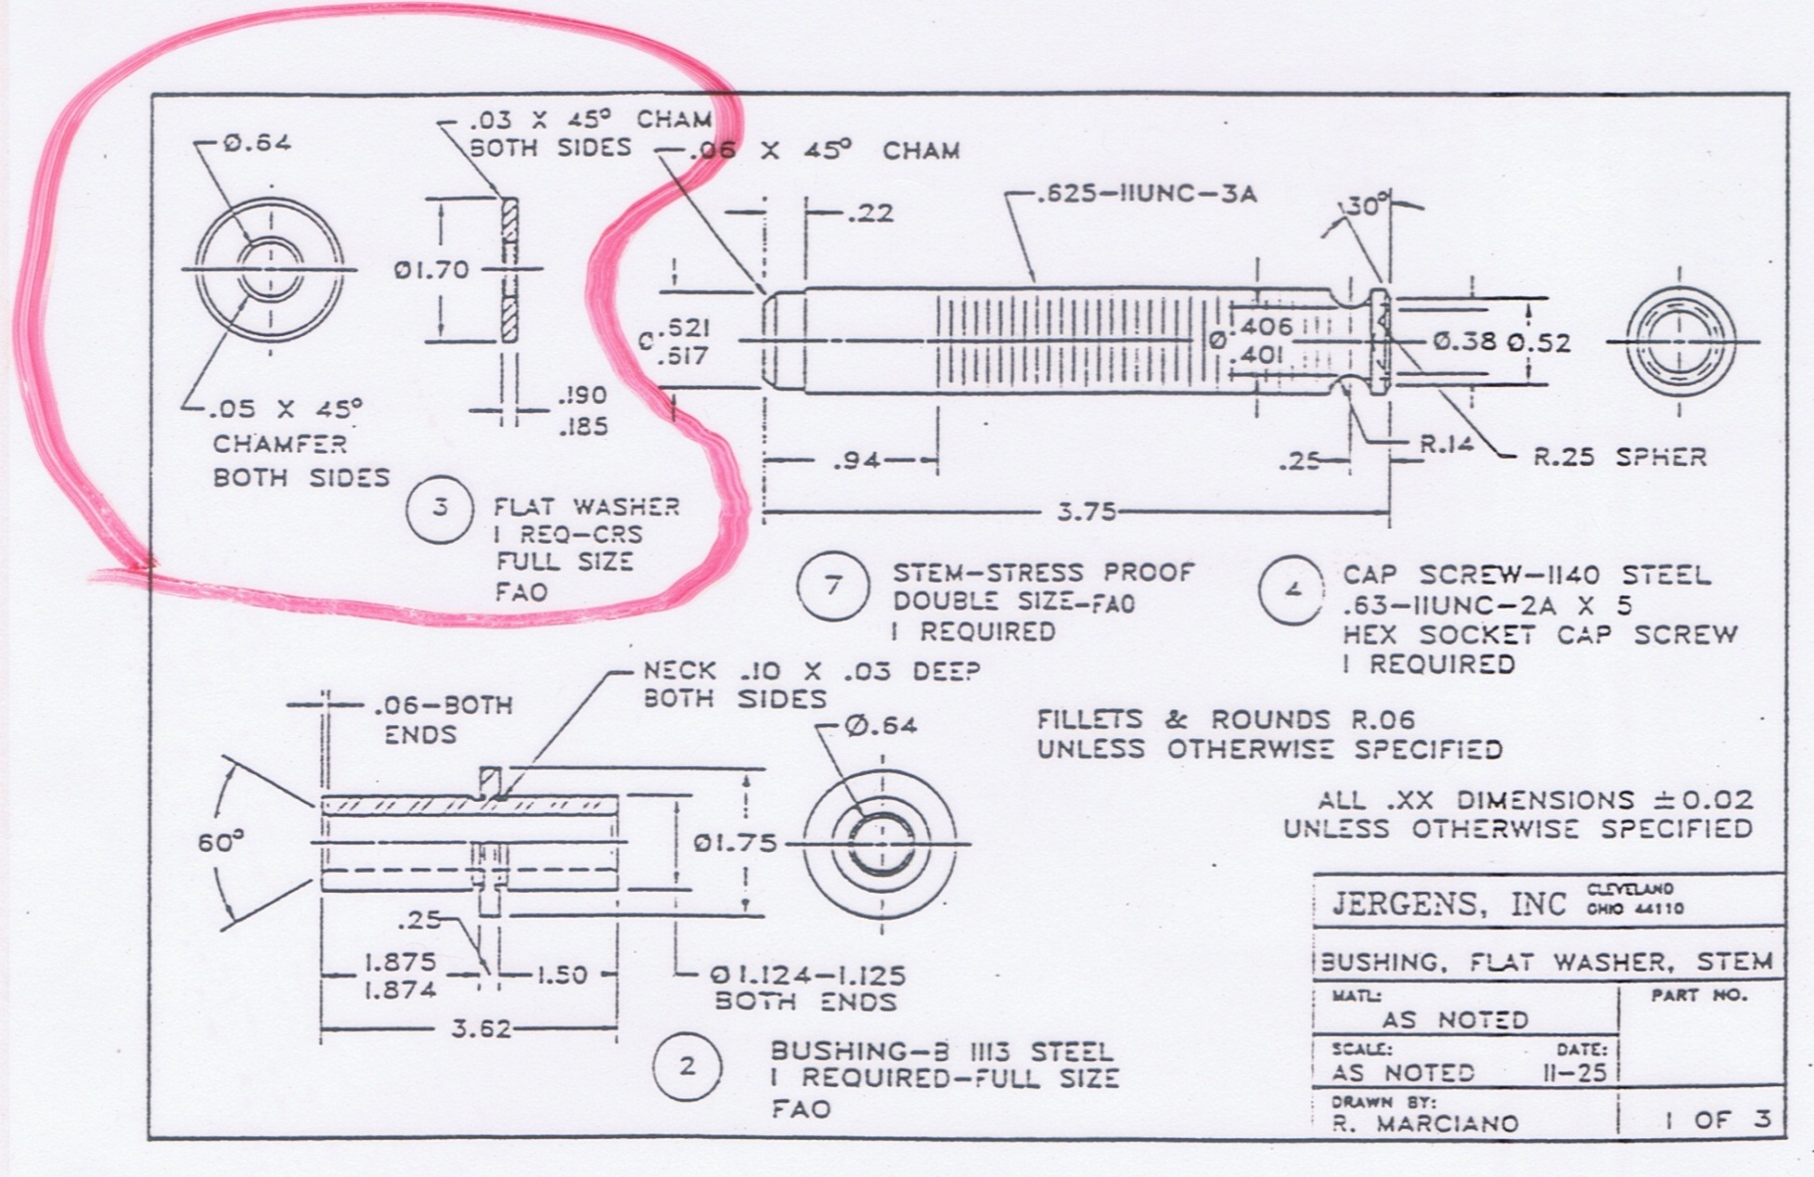

Slide 16
-- continued
The part number followed by the part name is given below each detail drawing.
Detail drawings are not needed for standard parts such as screws, threaded fasteners, bushing, bearings.

Slide 17
THANK YOU!

